Slide 1

NYC AIRBNB PRICE PREDICTION
Di An, Jie Chen, JiaRui Guo, QinYi Li, Yu Zhang, Zhirui Chen

Slide 2
Data Cleaning
Remove empty and NA rows
Change ‘f’ and ’t’ to ‘0’ and ‘1’: ’host_is_superhost’, 'host_has_profile_pic' , ’host_identity_verified' and 'instant_bookable'
Determine shared bathroom or not: 0 or 1
Remove outliers in data by using IQR
Categorize ‘room type’ and ‘neighbourhood’ into numbers
Convert price to log price
Notes:
To start with it, we used panda libraries to help us clean up the data. First we import the ‘listings_new.csv’ file, remove all the empty and NA rows in the csv file. In order to run model effectively in the following procedures, we changed those columns with "True" or "False" to ‘0’ and ‘1’. We also want to see whether an accommodation has a shared bathroom or not will be one of the reasons that affects the renting price, so we add a column to determine if it has shared bathroom. Furthermore, we changed the accommodation price into integer. Moreover, we removed outliers in data by using IQR method to increase the accuracy of our models. Finally, we categorized ‘room type’ and ‘neighbourhood’ into numbers and converted price to log price as the label which is what we are trying to predict in the later machine learning section.

Slide 3
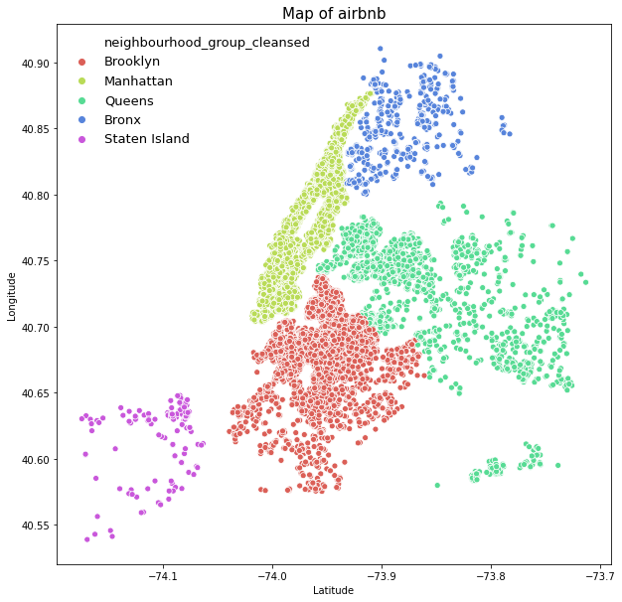
Map of Airbnb
Notes:
For the data visualization part, we make a map of all the listings into five boroughs base on the longitude and latitude.

Slide 4
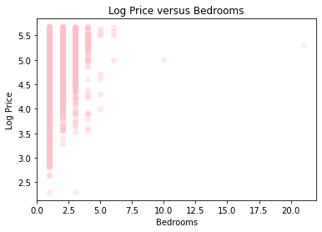
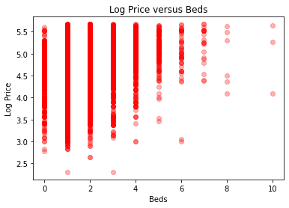
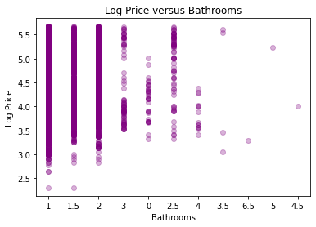
Price verse Bedrooms & Beds & Bathrooms
Notes:
We also shows the relationship between price and each different factor

Slide 5
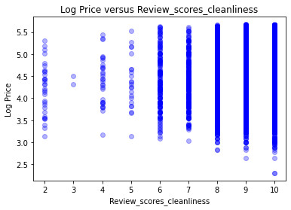
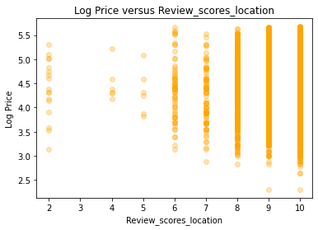
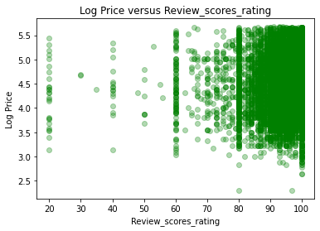
Price verse Review_Scores_Cleanliness/Location/Rating

Slide 6

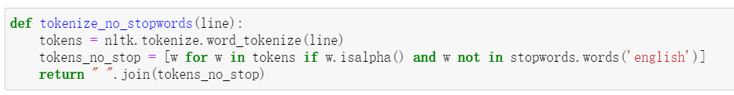
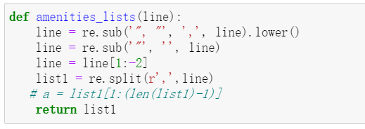
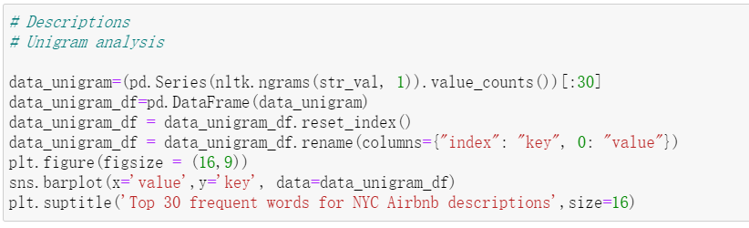
NLP -- Key Code

Slide 7
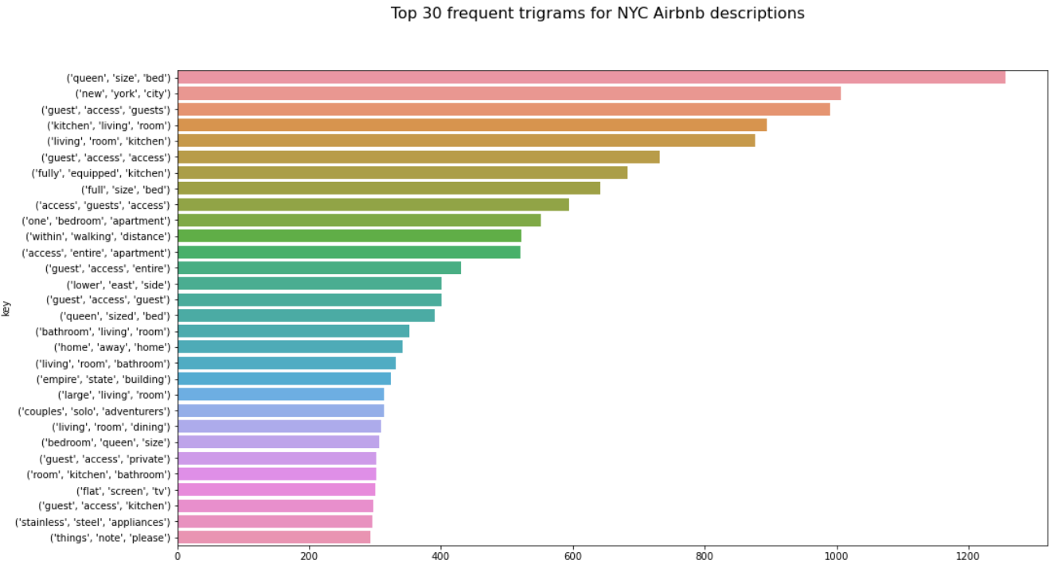
NLP -- Accommodation Description

Slide 8
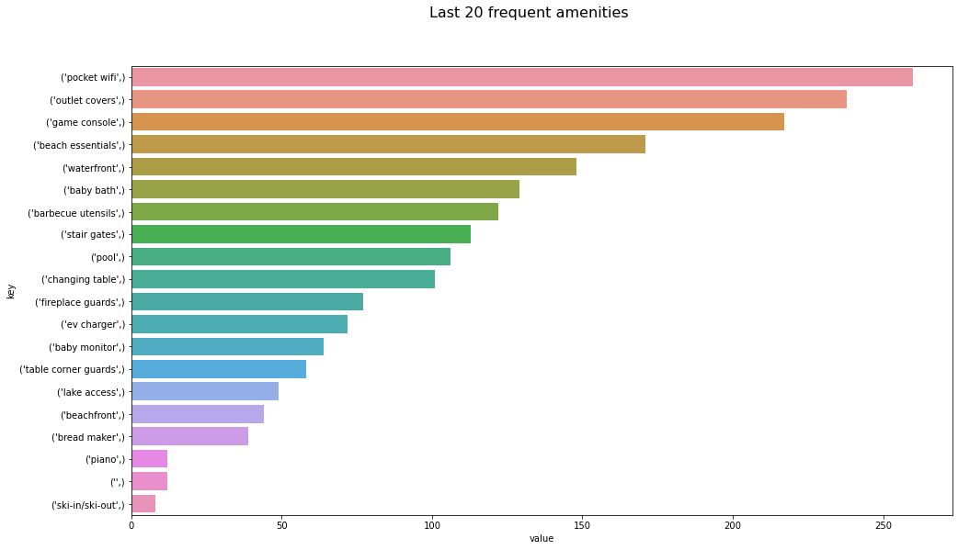
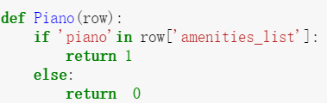
NLP -- Amenities

Slide 9
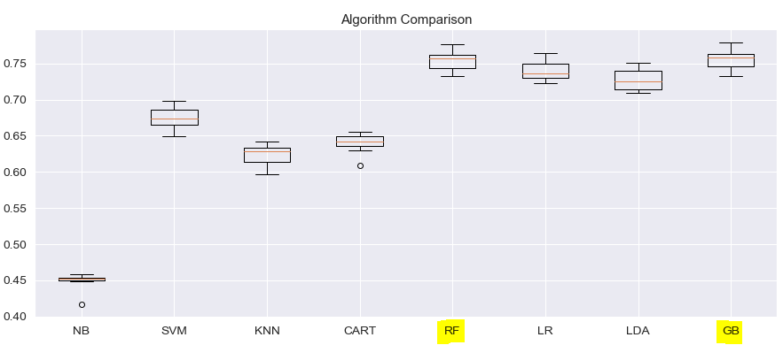
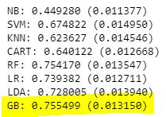
Machine Learning

Slide 10
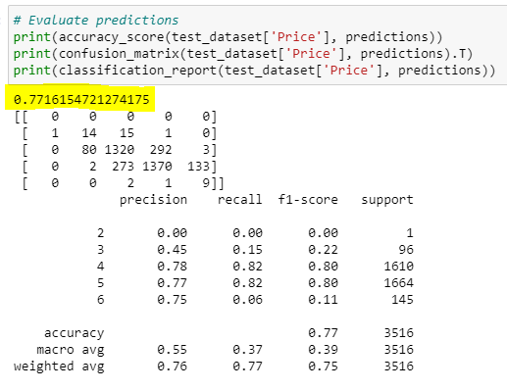
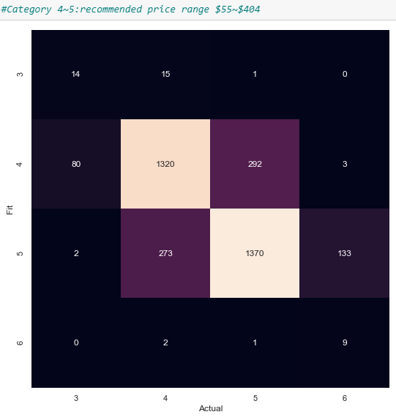
Machine Learning

Slide 11
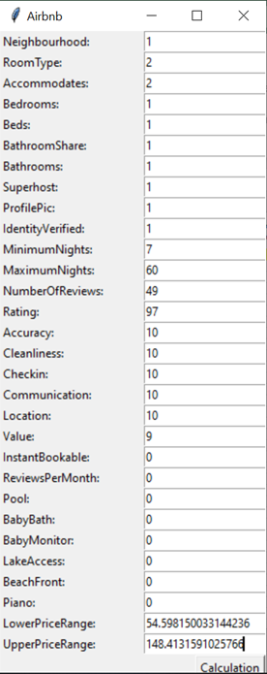
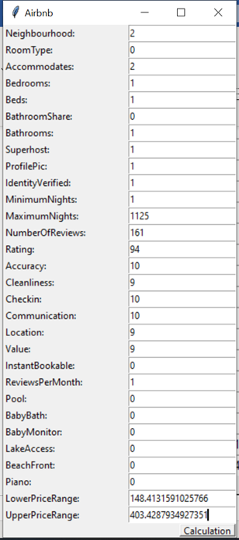
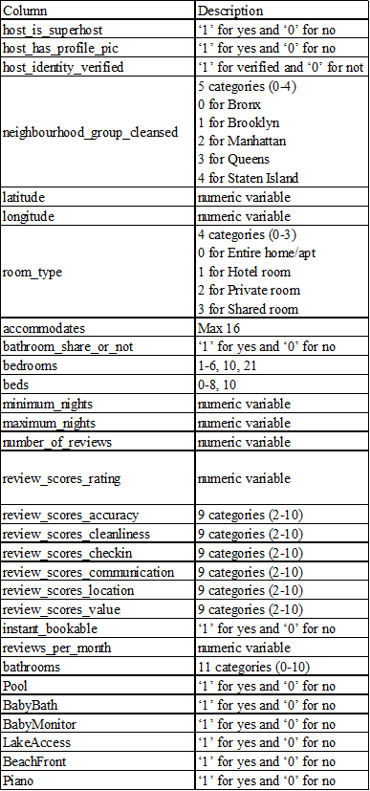
User Interface

Slide 12
Q&A

